Slide 1
NS Department of Computer Science and Engineering IBLE AND ETHICAL AI PRINCIPLES
M. Tech (CSE) – II Semester (Term: Jun-Sept 2022)
Non CIE Component
Quantum Computing (MCS22)
Non-Unitary Operations
Presented By:
Zakiya Banu

Slide 2
Unitary Operations
Operators
The Operator class is used in Qiskit to represent matrix operators acting on a quantum system. It has several methods to build composite operators using tensor products of smaller operators, and to compose operators.
Unitary Operators can be directly inserted into a QuantumCircuit using the QuantumCircuit. append method. This converts the Operator into a UnitaryGate object, which is added to the circuit.

Slide 3
Non Unitary Operations
Includes measurements, reset of qubits, and classical conditional operations.
Measurements
Access to all the information is not available while making a measurement in quantum computer. The quantum state is projected onto the standard basis. It places the binary result in a classical register. Below are two examples showing a circuit that is prepared in a basis state and the quantum computer prepared in a superposition state.
.

Slide 4
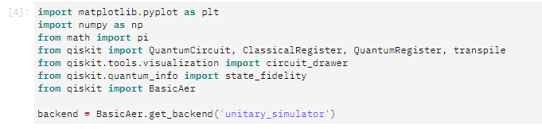
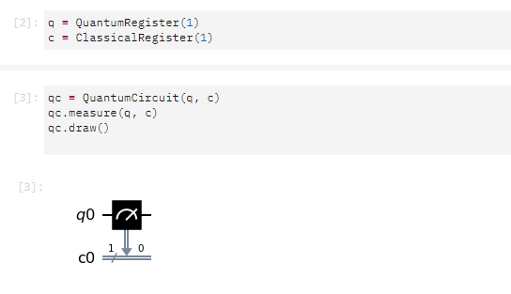

Slide 5
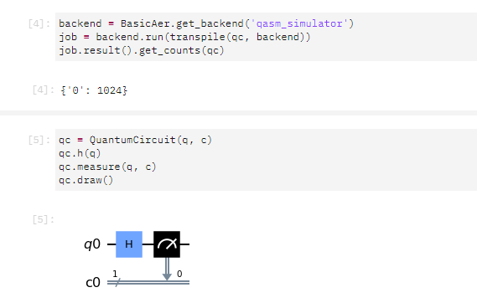
The simulator predicts that 100 percent of the time the classical register returns 0

Slide 6
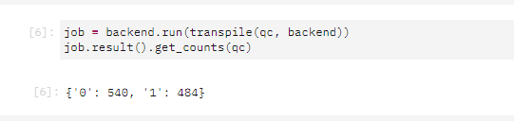
The simulator predicts that 50 percent of the time the classical register returns 0 or 1.

Slide 7
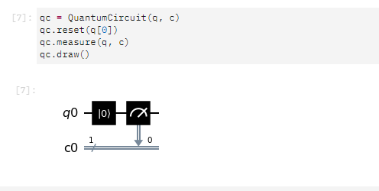
Reset
It is also possible to reset qubits to the |0⟩ state in the middle of computation. Note that reset is not a Gate operation, since it is irreversible.

Slide 8
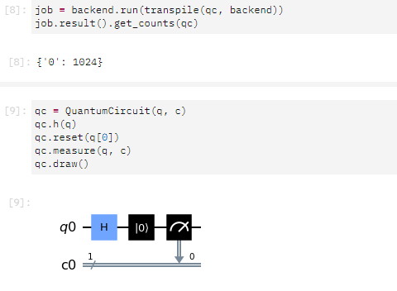

Slide 9
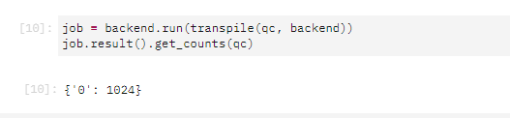
Here we see that for both of these circuits the simulator always predicts that the output is 100 percent in the 0 state.

Slide 10
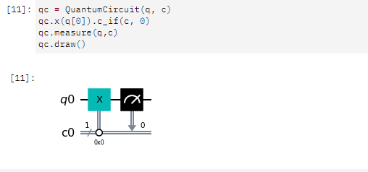
Conditional operations
It is also possible to do operations conditioned on the state of the classical register

Slide 11
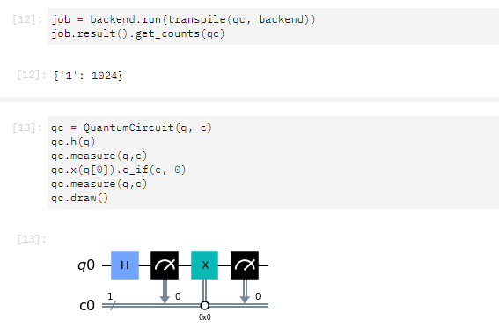

Slide 12
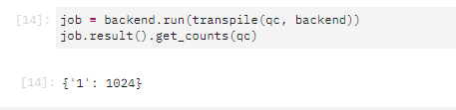
Here the classical bit by the first measurement is random but the conditional operation results in the qubit being deterministically put into |1⟩.

Slide 13

Multiple Qubits
If we have two qubits with individual states Iф> and Iψ>, their joint quantum state IΨ> is given by:
IΨ> = Iф> x Iψ>
where x represents the Kronecker product.
Kronecker product for vectors - The Kronecker product (also referred as the tensor product) is a special way to join vectors together to make bigger vectors. It possesses several properties that are often used to solve difficult problems in linear algebra and its applications.

Slide 14
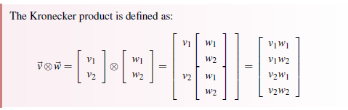

Slide 15
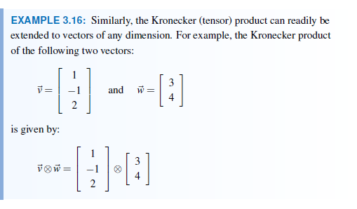
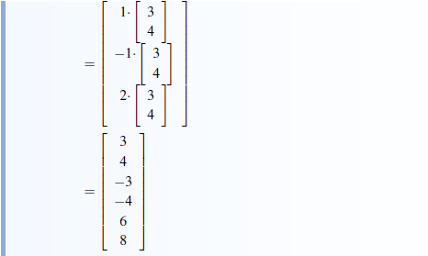

Slide 16
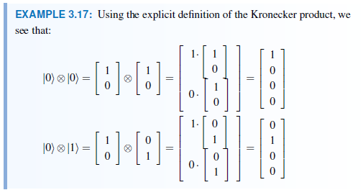
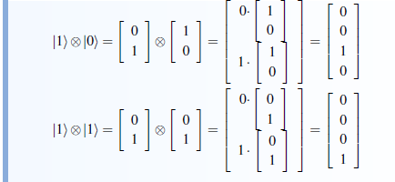

Slide 17
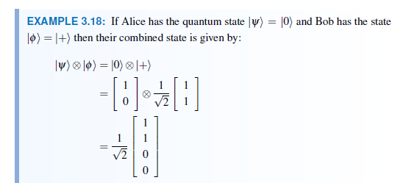

Slide 18
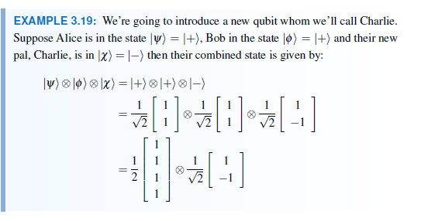
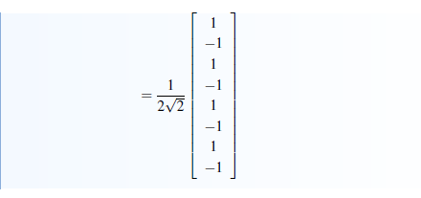

Slide 19
Question Hour
Non-Unitary operations (Explanation and code execution).
Multiple Qubits (Definition and examples).

Slide 20
References
[1] Summary of quantum operations¶. Summary of Quantum Operations - Qiskit 0.37.1 documentation. (n.d.). Retrieved August 19, 2022, from https://qiskit.org/documentation/tutorials/circuits/3_summary_of_quantum_operations.html#Non-unitary-operations.
[2] Scherer. (2019). In Mathematics of quantum computing. essay, Springer International Publishing.

